Slide 1
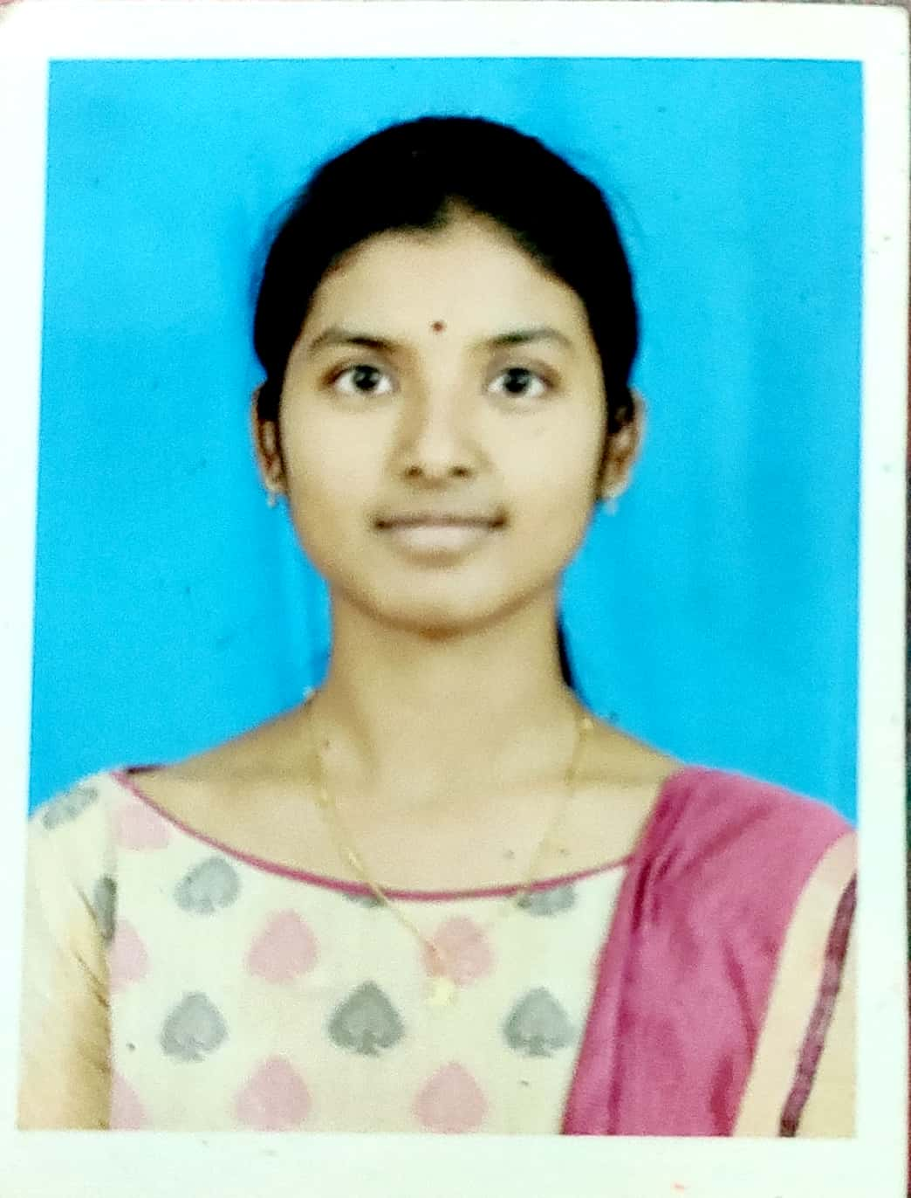
SANAMBATLA YASHASWINI SOFTWARE ENGINEER
hhh
SUMMARY
PROFESSIONAL ACHIEVEMENTS
To work in a challenging environment that provide me open-handed opportunities for learning & improvement in my career.
Worked on Real Time IOT application-based project under the aegis of ExpertsHub held at AITS, Tirupathi.
Participated the event named Sigmoid 2K18 on the paper entitled 5G Technology in National Level Technical Symposium & won the First Prize at SV University, Tirupathi.
Worked on "An Advanced Embedded System for Women Safety using Arduino".
TOOLS & TECHNOLOGY:
CAREER ACHIEVEMENTS
MySQL
Maven
Java
Jenkins
GitHub
Eclipse
Visual Studio
Awarded as a "Best poster in CII IWN AP" , Poster making competition held as a part of International Women's Day Celebrations , March 2018 at Tirupathi.
Awarded Elite in NPTEL Online Certification on "Introduction to Internet Of Things" from IIT Kharagpur in 2018.
Selected in State level NCSC for the project "Utilization of Organic fertilizer" in 2011.
PERSONAL SKILLS:
Leadership skill
Self-Motivated
Ability to multi-task.
Dedicated
RELEVANT WORK EXPERIENCE
Worked on developing application using Spring & Hibernate, Angular, Spring boot & Microservices.
Hands-on experience in Spring MVC web as the framework developed a web application as a mini project.
Worked on Eclipse, Web Technologies, MySQL, Apache Tomcat, Visual Studio and Maven.
EDUCATION:
Completed my Graduation in the stream of Electronics & Communication Engineering at AITS, Tirupathi in the year 2020 with 82.3%.

